Slide 1
Geographic Data:
Understanding the World Around Us
Sat 23rd April, 9:30am – 4pm
Dr Nick Bearman
@nickbearmanuk
Department of Geography and Planning

Slide 2


Welcome
Introductions
Who are you?
What do you want from the course?
What Google Earth / Sat Nav / GIS have you used before (if any!)?

Slide 3
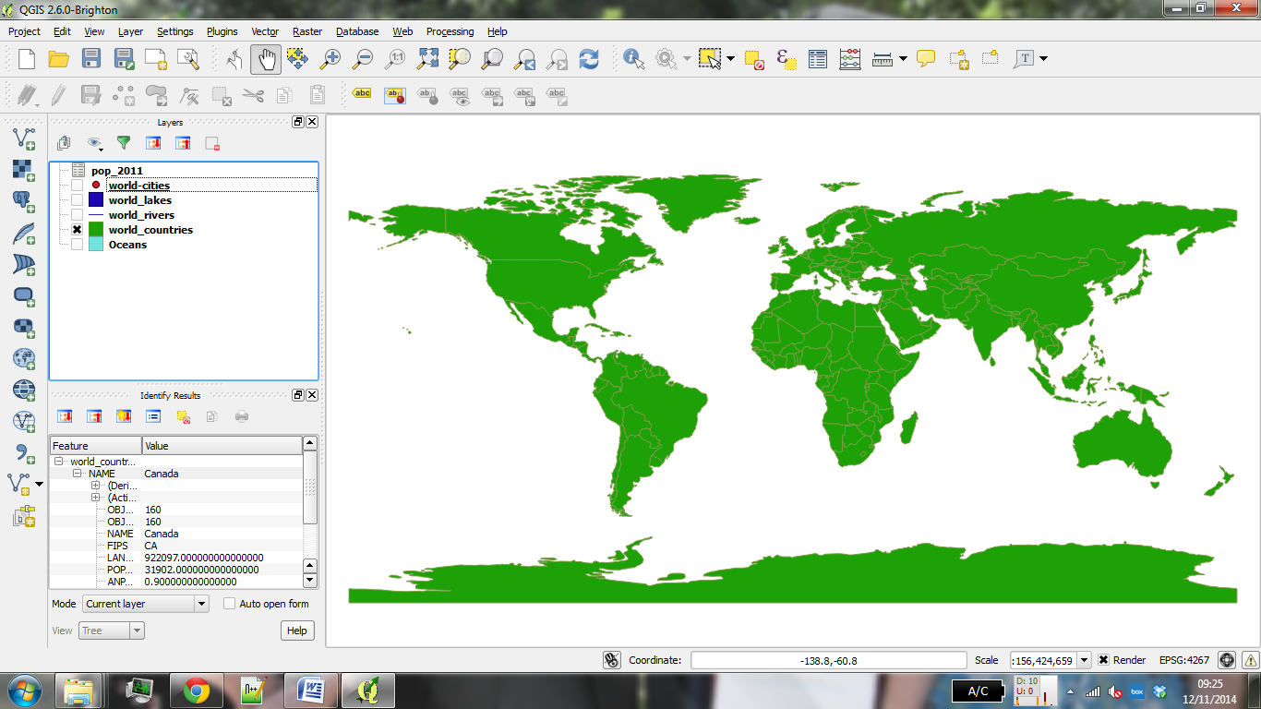
What will you get from the course?
Background on spatial data
GIS & QGIS
Load spatial data

Slide 4
What will you get from the course?
Basic spatial analysis
Appropriate methods of visualizing data
Creating a publication quality map
Presentations etc. are available online

Slide 5
Outline of the day
9:40am - 10:00am – What is GIS?
10:00am - 10:20am – Google Earth
10:20am - 11:00am – Prac.1 Intro to QGIS
11:00am - 11:30am – Coffee (room 116)
11:30am - 12:00pm – Classification
12:00pm - 1:00pm – Practical 1 Intro to QGIS 1:00pm - 2:00pm – Lunch (room 116)
2:00pm - 2:15pm – Recap and Map Design
2:15pm - 4:30pm – Practical 2 Tiger Map
Notes:
Practical 2 – Bring Your Own Data

Slide 6
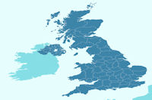
What is Geographic Information?
Everything has a location
Where are we?
Where are we going?
How things relate to one another is important
Is this shop on my route to work?
Do high crime areas cluster together?
https://census.ukdataservice.ac.uk/get-data/boundary-data

Slide 7

http://www.youtube.com/watch?v=jXqLHSBP_x0

Slide 8

http://www.youtube.com/watch?v=jXqLHSBP_x0

Slide 9
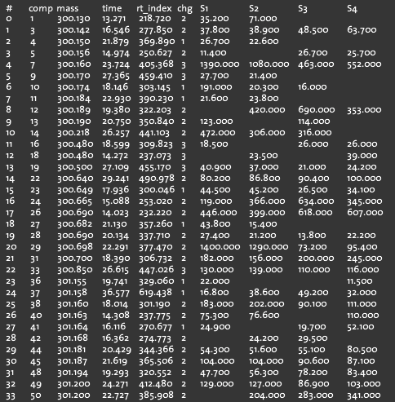
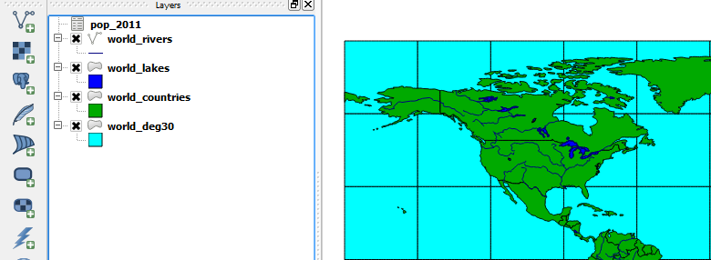
What is GIS? (Geographical Information Systems)
Turning (spatial) data into information
Using this information to answer questions
How have housing conditions changed in the past ten years?
http://www.flickr.com/photos/dsleeter_2000/3097476532 & ESRI Course “Teaching with GIS”

Slide 10
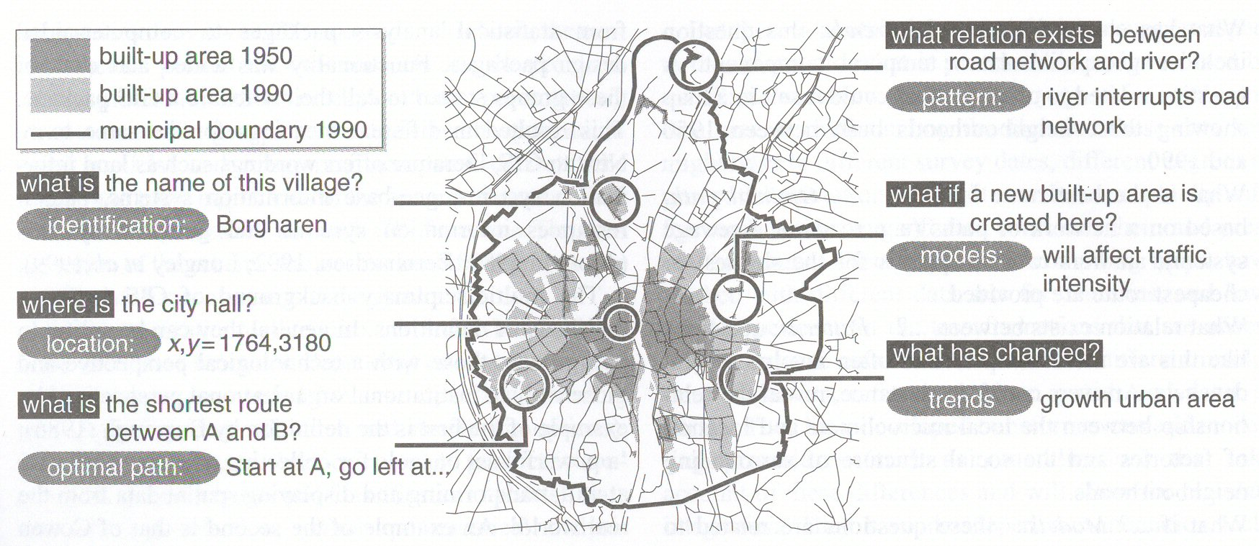
Types of questions a GIS can answer
Source: Kraak & Ormeling (2003) p.7.
Notes:
We can use a GIS for an almost infinite range of purposes, including…
-Location-based queries (e.g. where is the community centre?)
Relationship-based queries (e.g. where is the nearest Well or bore hole?)
Network analysis (e.g. what is the shortest route between A and B?)
Trend analysis (e.g. how has land use changed between time A and time B?)
3D visualisation (e.g. displaying 3d flood models)
This course will give you experience in using all three levels of using geographic information systems.

Slide 11
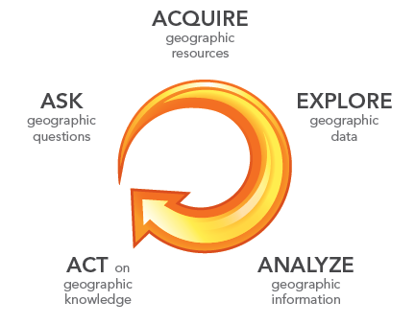
What is GIS?
http://www.flickr.com/photos/dsleeter_2000/3097476532 & ESRI Course “Teaching with GIS”

Slide 12
GIS – Geographic Information Systems
Almost all human activities and decisions involve an important geographic component
the ‘where?’
Working with geographic information involves unique, complex and difficult choices
Why we need specialized software
organize and store
access and retrieve
manipulate and synthesize
apply to the solution of problems

Slide 13
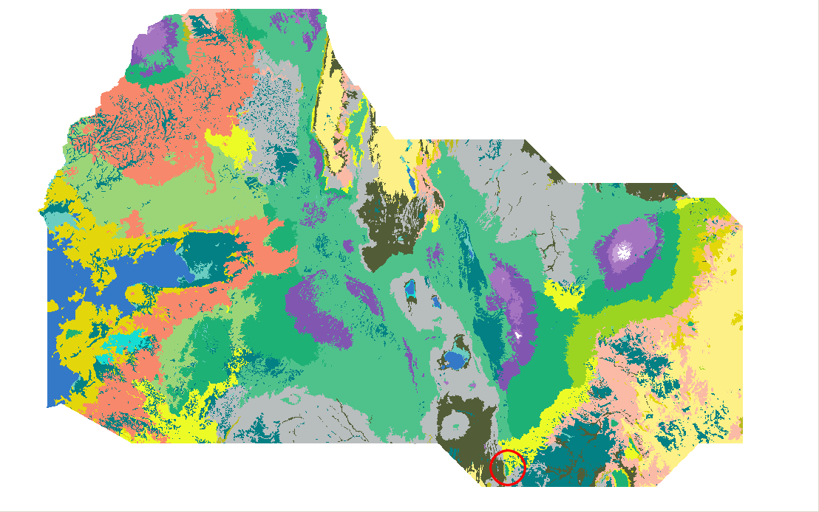
Kenya Vegetation Figure 1 - http://pvanb.wordpress.com/2010/06/10/clickfu-in-qgis/

Slide 14
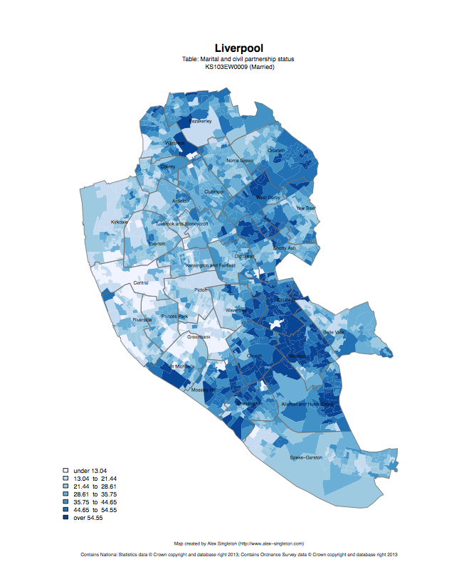
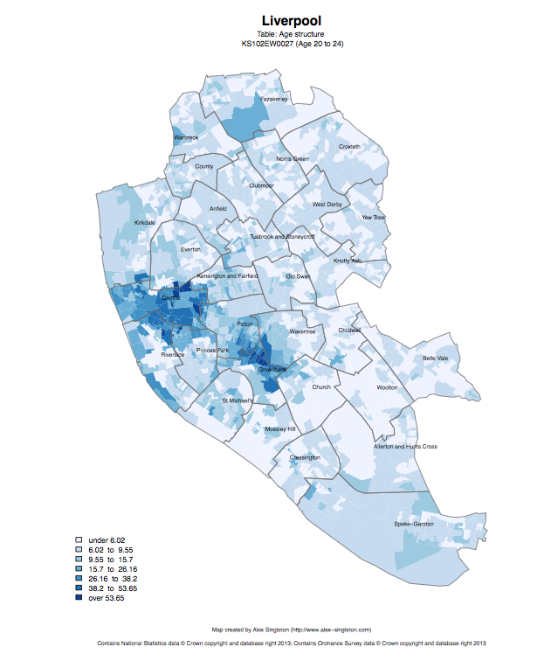
Census 2011
Married
Age structure – 20 to 24
http://www.alex-singleton.com/r/2014/02/05/2011-census-open-atlas-project-version-two/

Slide 15
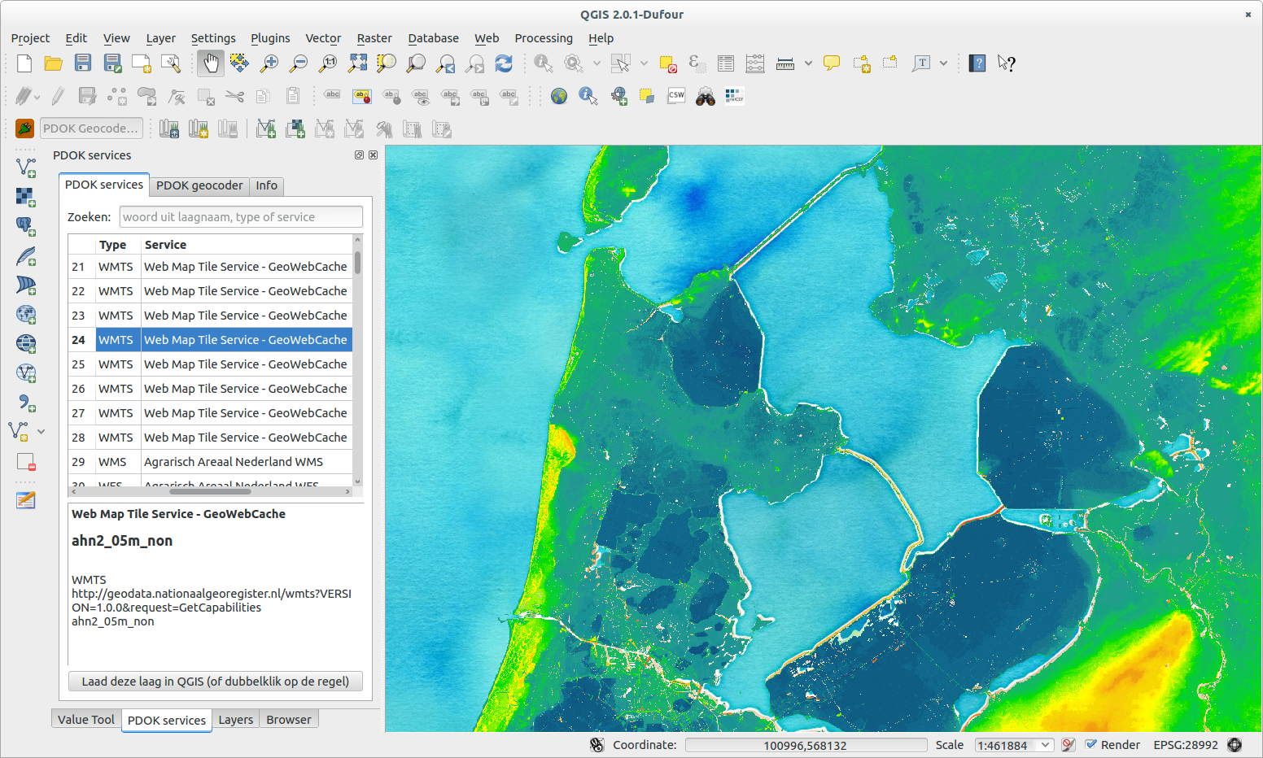
Netherlands Topography - https://publicwiki.deltares.nl/display/OET/Dataset+documentation+AHN2

Slide 16
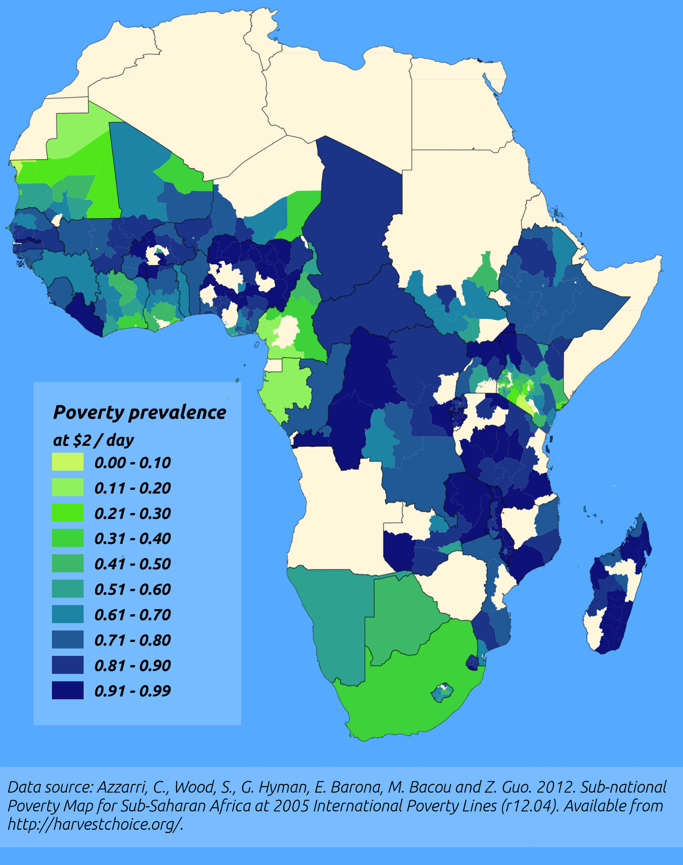
http://pvanb.wordpress.com/2012/05/09/poverty-maps-on-harvestchoice/

Slide 17
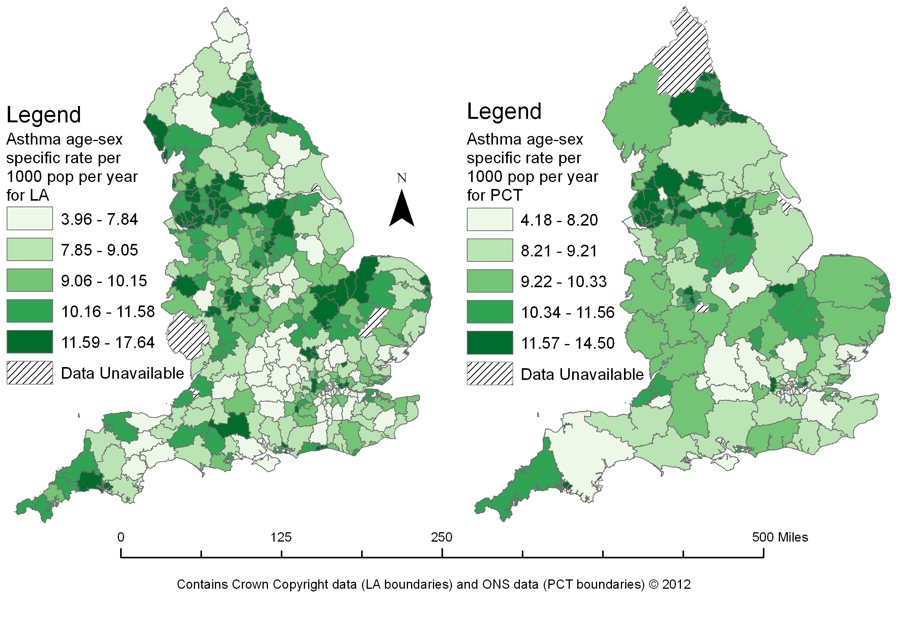

Slide 18
What do we use to do this?
Geographical Information System – GIS (ArcGIS/QGIS)
Geo-browsers (Google Earth)
Participatory Rural Appraisal (PRA)
Drawing maps
Level of sophistication/cost

Slide 19
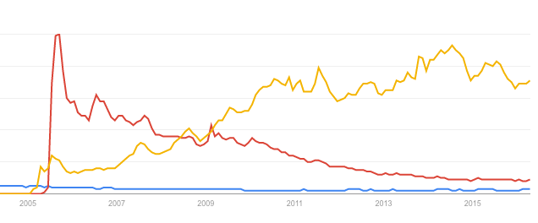
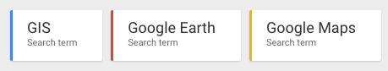
Google Earth / Google Maps
The release in 2005-6 of freely downloadable software such as Google Earth has had great public impact.
From https://www.google.com/trends/ on 21/04/2016

Slide 20


Open Internet Explorer
Go to maps.google.co.uk
Find where we are now (L69 7ZQ)
What is in the area?
How did you get here this morning?
What other transport options did you have? (try Directions)
(5 min)

Slide 21
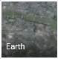

Google Maps
Try different options:
(Earth, 3D, Directions, Street View, Mouse Wheel, Rotate View, zoom out to the world)
Repeat what we did before:
Find where we are now (L69 7ZQ)
What is in the area?
How did you get here this morning?
What other transport options did you have?
(5 min)
What’s different? What’s the same?

Slide 22




Other GIS software?
QGIS has many features, but fewer than ArcGIS
QGIS is free (as is R)
QGIS is increasingly popular in not for profit sector, academic and commercial
All can be useful

Slide 23
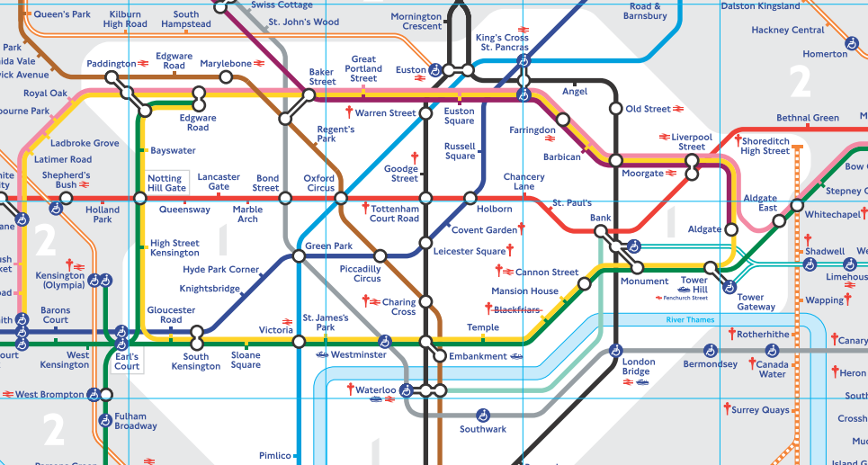
Using Different Maps

Slide 24
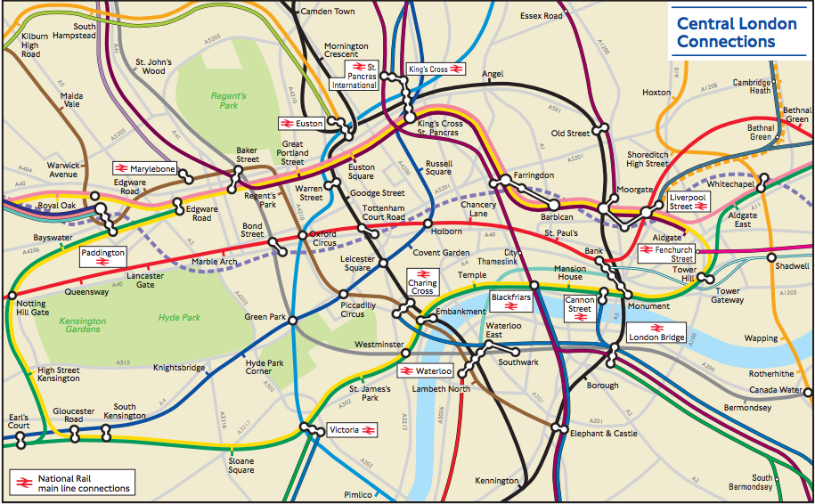
http://www.timeout.com/london/blog/tfl-has-secretly-made-a-geographically-accurate-tube-map-091515

Slide 25
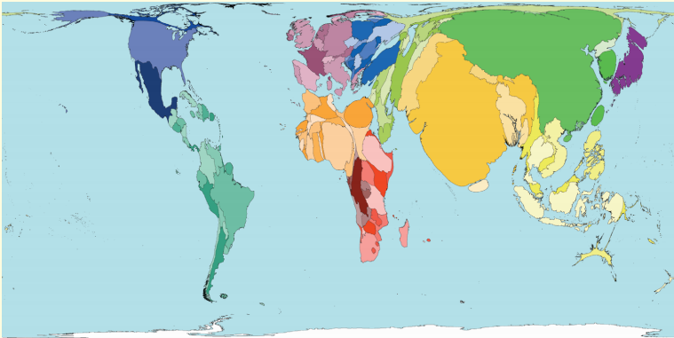
Cartograms
http://www.worldmapper.org/display.php?selected=2

Slide 26
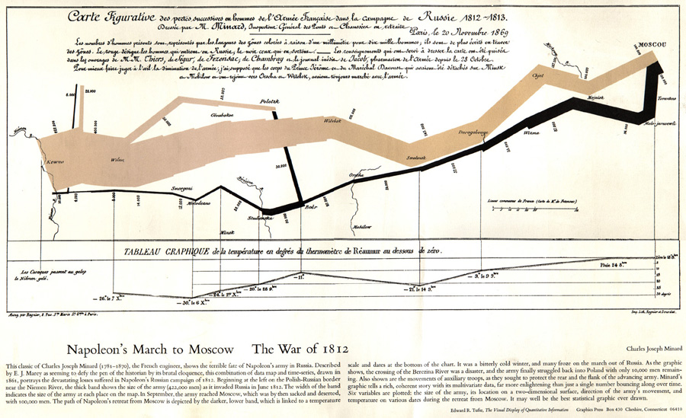

Slide 27
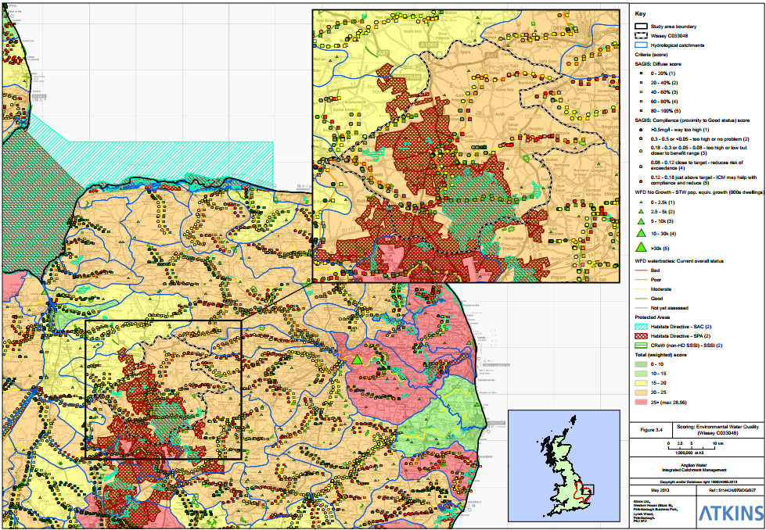
Identifying catchments that might benefit from ICM...

Slide 28
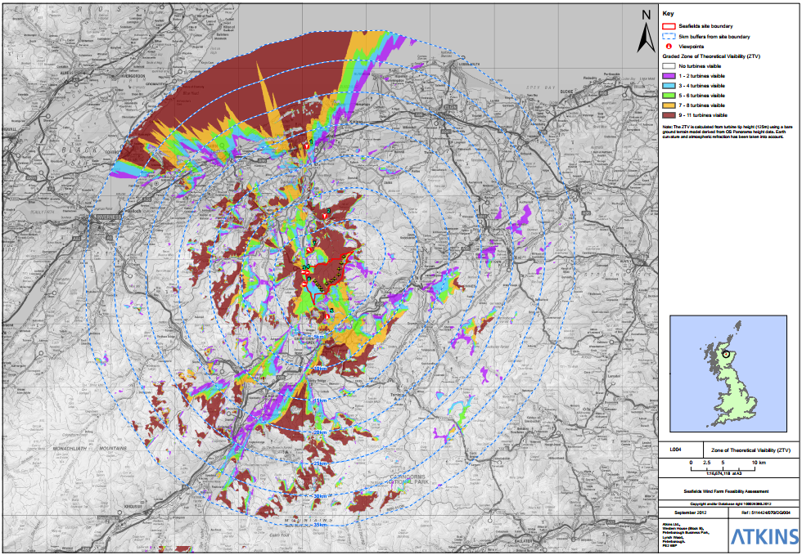
Determining views of proposed wind turbines...

Slide 29
Important Theory!
Projections and Coordinate Systems
Joining Data

Slide 30
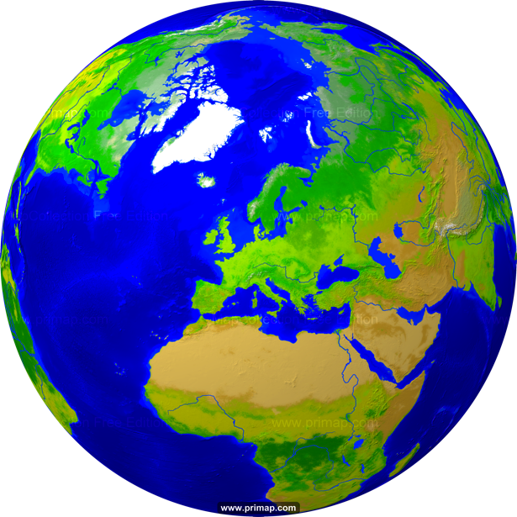
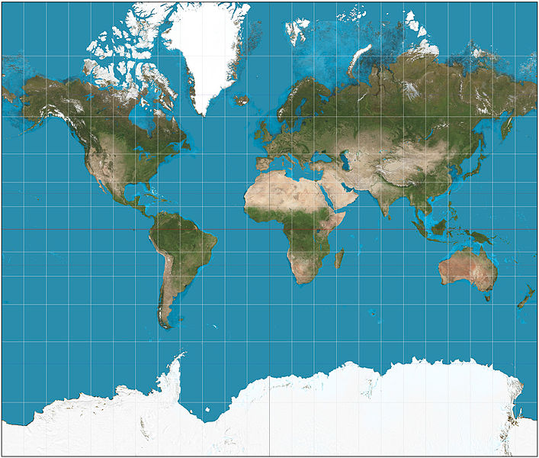
Projections
Projection – going from a sphere to a flat surface
http://www.primap.com/wsen/Maps/MapCollection/WorldMaps/Globe-(Europe-centered)-Vegetation-4000x4000.html

Slide 31

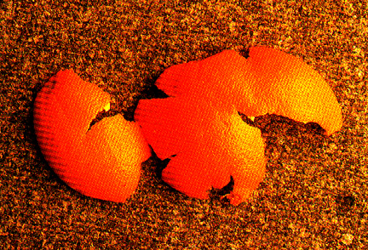
Projections
Projection – going from a sphere to a flat surface
http://krygier.owu.edu/krygier_html/geog_353/geog_353_lo/geog_353_lo05.html
http://www.hdwallpapersos.com/orange-fruit-hd-wallpapers.html

Slide 32
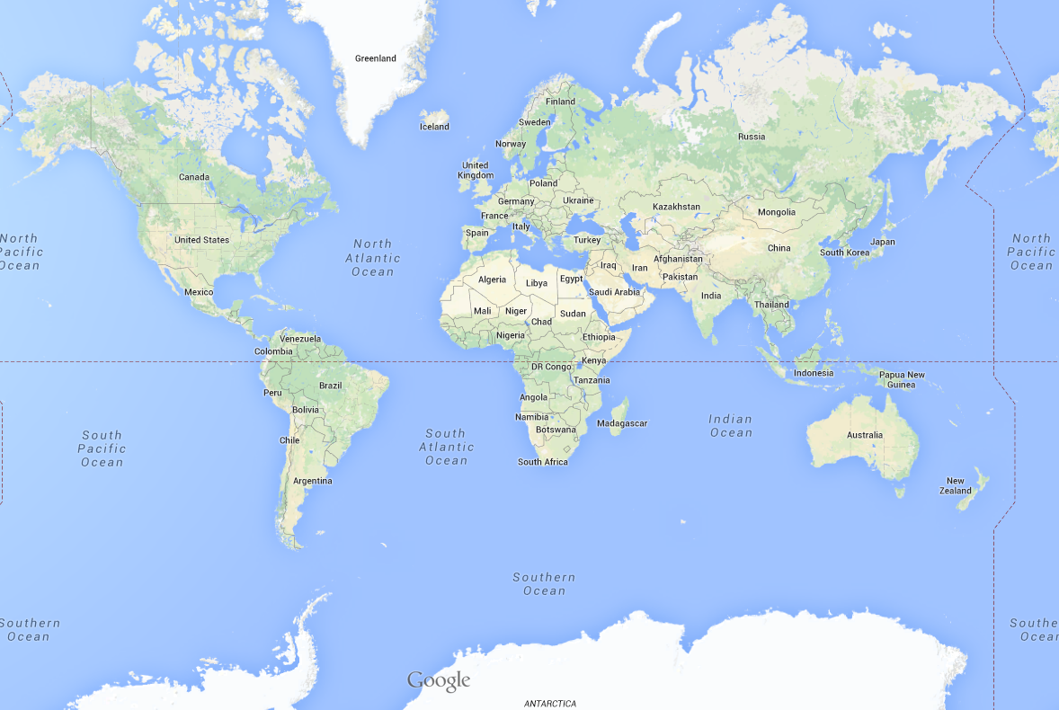
This file is licensed under the Creative Commons Attribution-Share Alike 3.0 Unported license. http://en.wikipedia.org/wiki/File:Mercator_projection_SW.jpg
Mercator projection

Slide 33
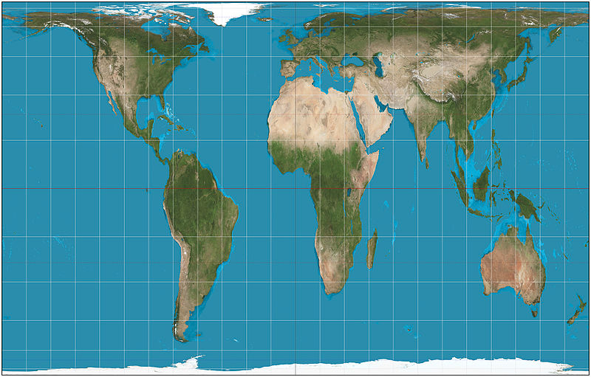
This file is licensed under the Creative Commons Attribution-Share Alike 3.0 Unported license. http://en.wikipedia.org/wiki/File:Mercator_projection_SW.jpg
Mercator projection
Peters projection
This file is licensed under the Creative Commons Attribution-Share Alike 3.0 Unported license. http://en.wikipedia.org/wiki/File:Gall%E2%80%93Peters_projection_SW.jpg

Slide 34
Africa: 30 million sq km
Greenland: 2 million sq km

Slide 35
Projections etc.
Africa: 30 million sq km
Greenland: 2 million sq km

Slide 36
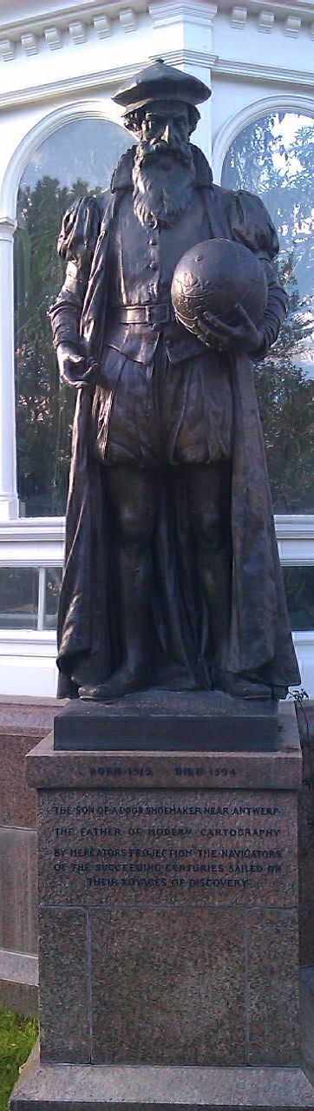
Mercator
“The Father of Modern Cartography”
By Mercator’s Projection the navigators of the succeeding centuries sailed
1569
Notes:
Maintains angle but not area.

Slide 37
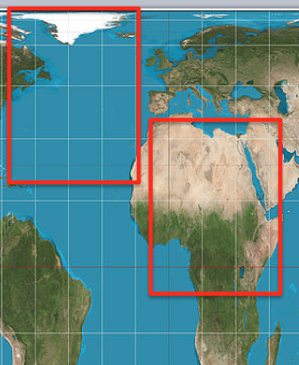
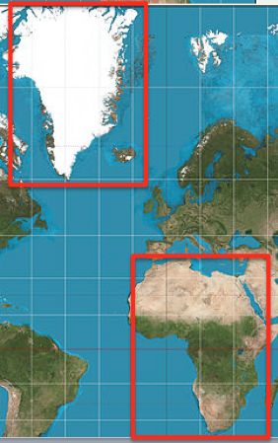
Why are Projections important?
The map(s) may not be as they appear
Data may appear in the wrong place

Slide 38
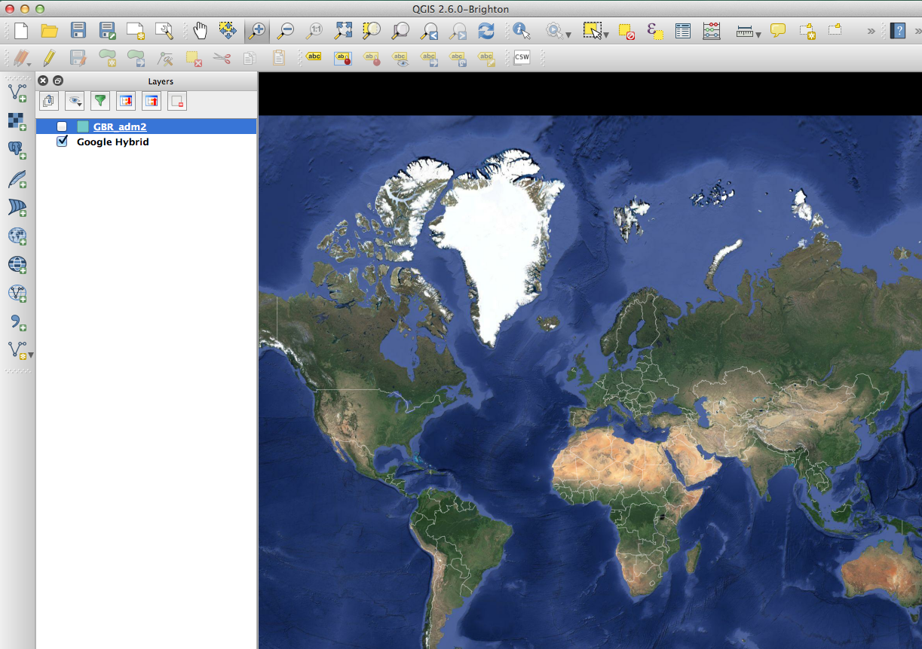

Slide 39
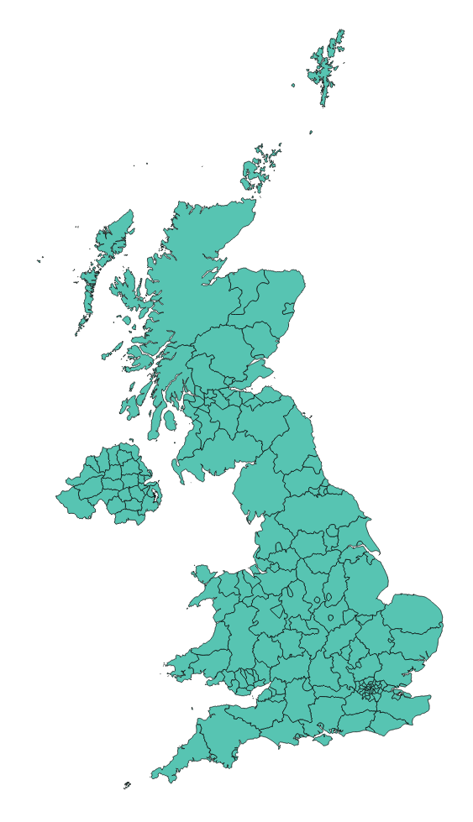

Slide 40
Why are Projections important?
The map(s) may not be as they appear
Data may appear in the wrong place
Coordinate Systems

Slide 41
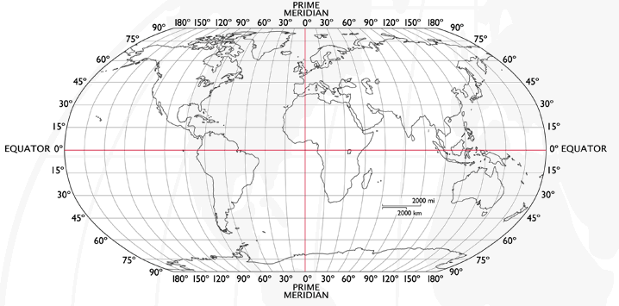
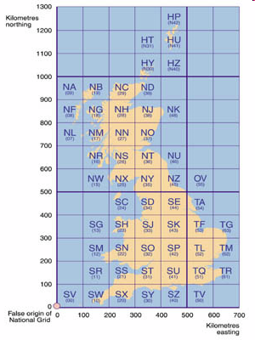
Coordinate Systems
Latitude and Longitude (WGS 1984) EPSG = 4326
52°N 37’ 30.32’’ (52.6250) 1°E 14’ 2.05’’ (1.2339)
British National Grid (Eastings & Northings)
Easting: 619301 Northing: 307416 EPSG = 27700
Why is it important?
Some data uses uses WGS84
LSOA use BNG (Eastings/Northings)
Need to convert between the two
Notes:
-Coordinate Systems are derived from projections and are used to give coordinates (numbers) to locations on the Earth’s surface
-Best if your data is all in the same coordinate system (otherwise the coordinates might be slightly different for the same location), but ArcMap can convert between them
-Most common:
-Lat/Long (also WGS 1984) used by most GPS
-BNG (British National Grid) very common in UK data – Ordnance Survey format.
-Most important – are all your data in the same coordinate system?
-ArcMap can convert, but often if your data appears in the wrong place, it is because there is something wrong with the coordinate system.
http://www.worldatlas.com/webimage/testmaps/latslongs.htm
http://www.ordnancesurvey.co.uk/oswebsite/gps/information/coordinatesystemsinfo/guidetonationalgrid/page13.html
http://www.ordnancesurvey.co.uk/oswebsite/gps/information/coordinatesystemsinfo/guidetonationalgrid/page8.html

Slide 42
Joining
Area ID
1
2
3
4
5
14
7
8
11
Area ID | Deprivation
1 | High
2 | High
3 | High
4 | Average
5 | Average
6 | Average
7 | Low
8 | Low
9 | Low
10 | High
11 | Low
12 | High
13 | High
14 | Average
15 | Average
1
2
3
14
4
7
5
8
11
Data
Polygons
Lookup

Slide 43
1
Area ID | Deprivation
1 | High
2 | High
3 | High
4 | Average
5 | Average
14 | Average
7 | Low
8 | Low
11 | Low
2
3
14
4
7
5
8
11
High Deprivation
Average Deprivation
Low Deprivation

Slide 44
QGIS follow on screen
bit.ly/qgisprac1
www.github.com/nickbearman/intro-qgis-spatial-data/

Slide 45
Make new Folder
DL zip
Unzipping it
Open QGIS
Add world_countires
Zoom & pan

Slide 47
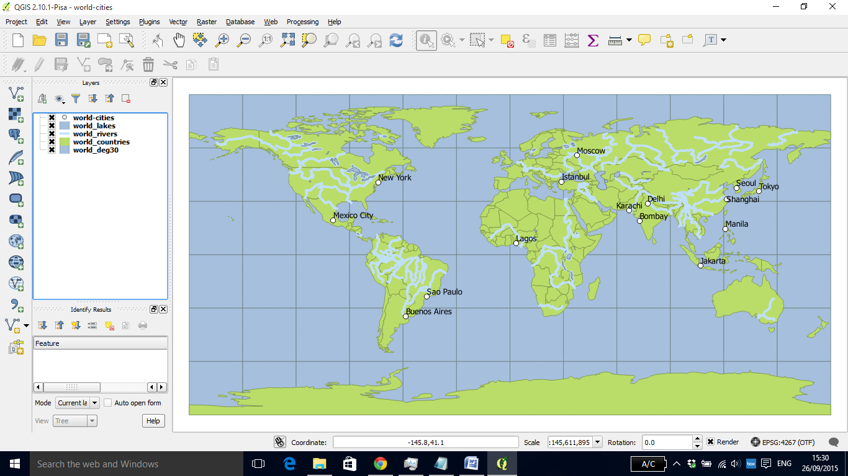

Slide 49
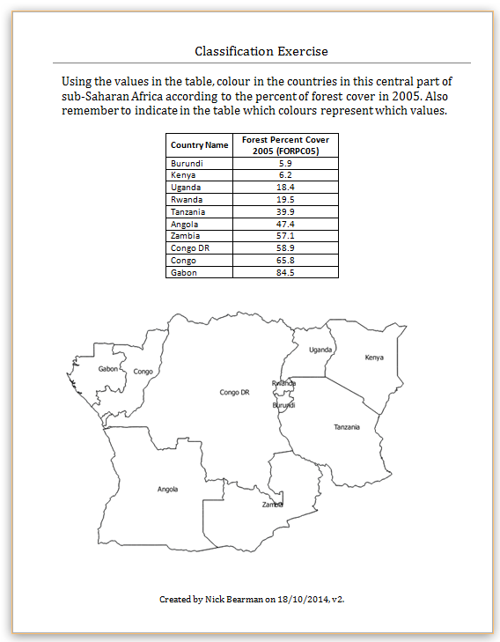
Classification
Colour in the values for Forest Cover (10 min)
Discuss your choices

Slide 50
Classification
Colour in the values for Forest Cover (10 min)
Discuss your choices
Colours
Classes

Slide 51
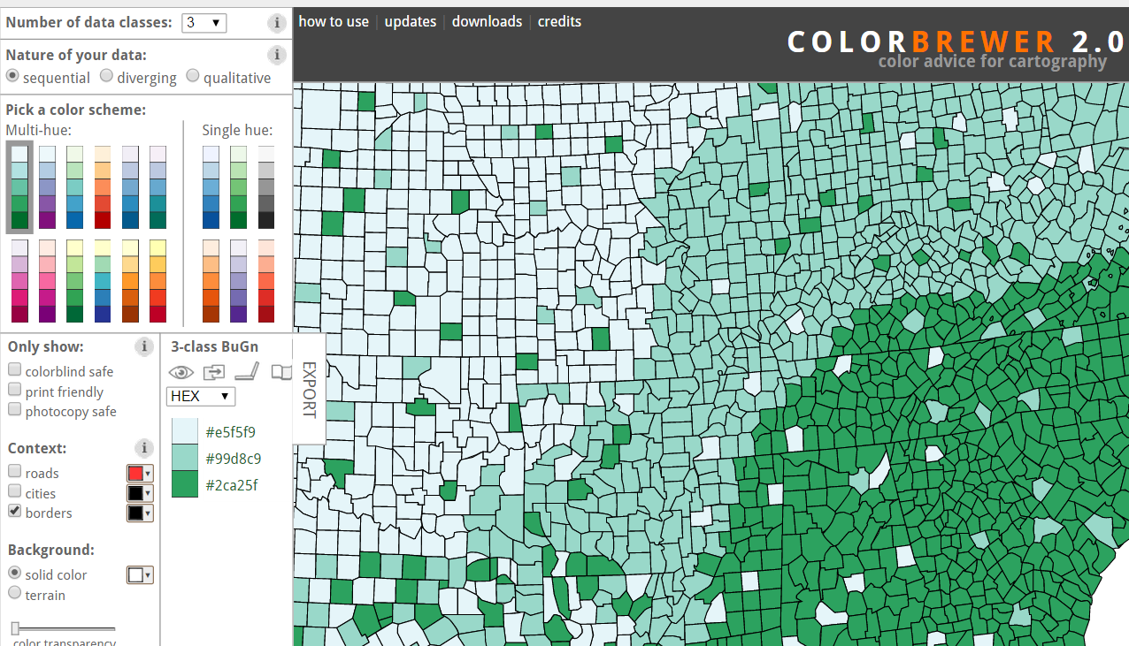
Map Design: Classification
Choropleth maps have colours
How do you choose the colours?
Why is this important?
Output
User
colorbrewer.org

Slide 52
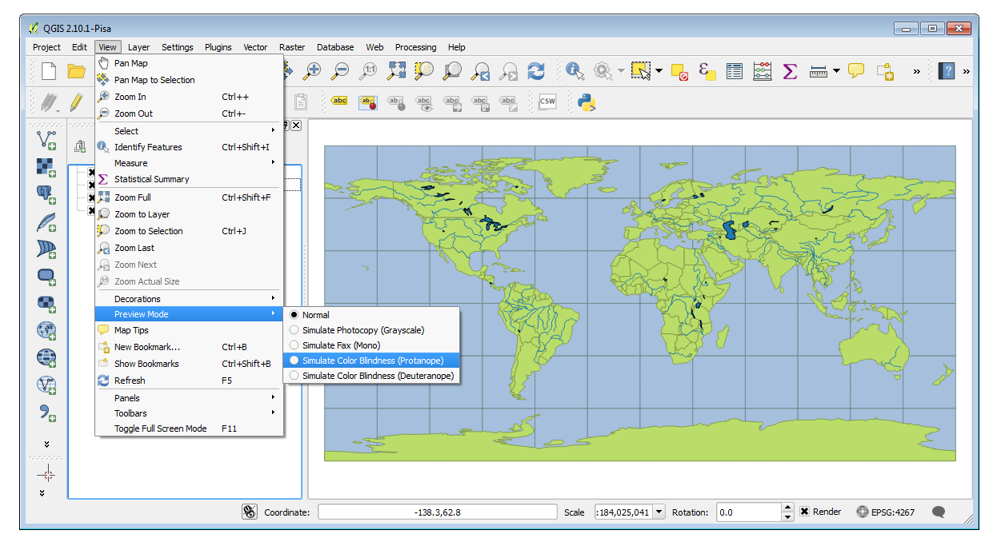
http://nyalldawson.net/2014/05/and-now-colour-preview-modes-in-qgis-map-canvas/

Slide 53
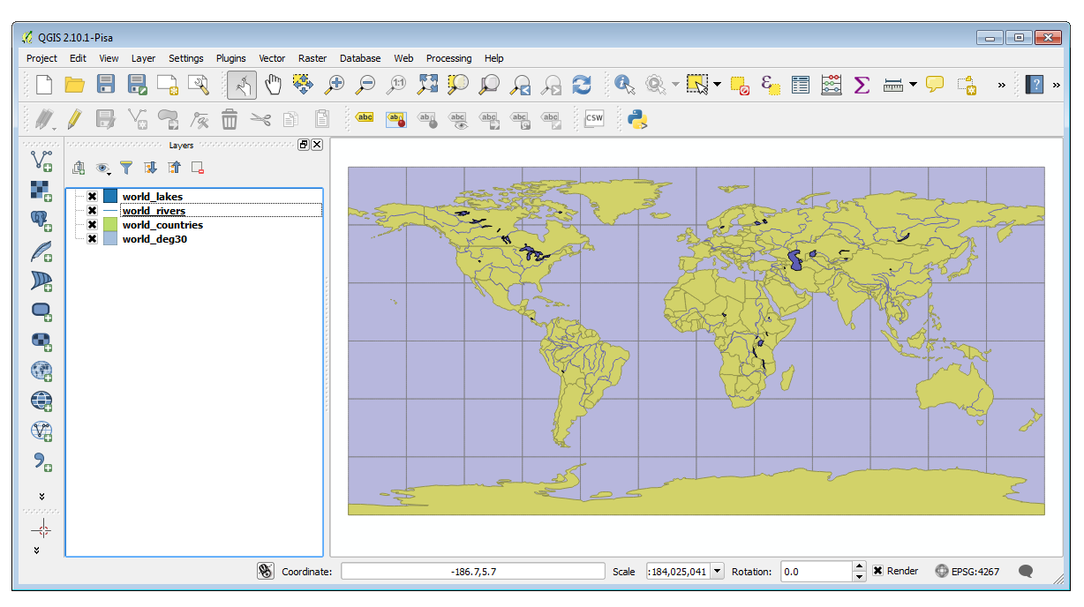
http://nyalldawson.net/2014/05/and-now-colour-preview-modes-in-qgis-map-canvas/
Notes:
Doesn’t work in OSX
See: https://hub.qgis.org/issues/10761

Slide 54
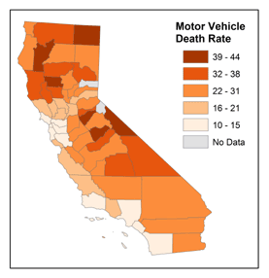
Map Design: Classification
Choropleth maps have classes
How do you choose the classes?
Why is this important?
© 2014 The Pennsylvania State University, https://www.e-education.psu.edu/geog486/l4_p7.html#classification_schemes

Slide 55
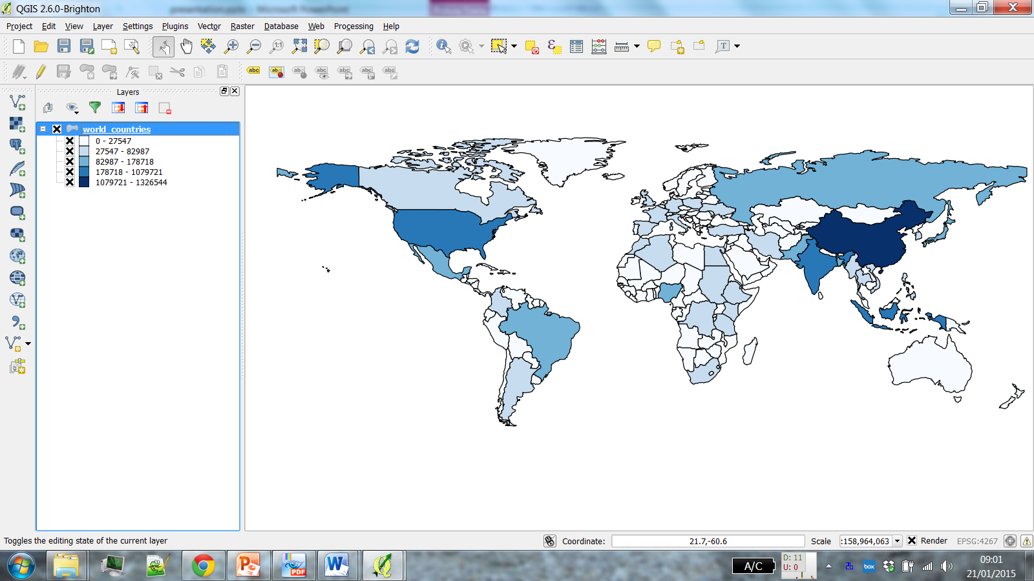
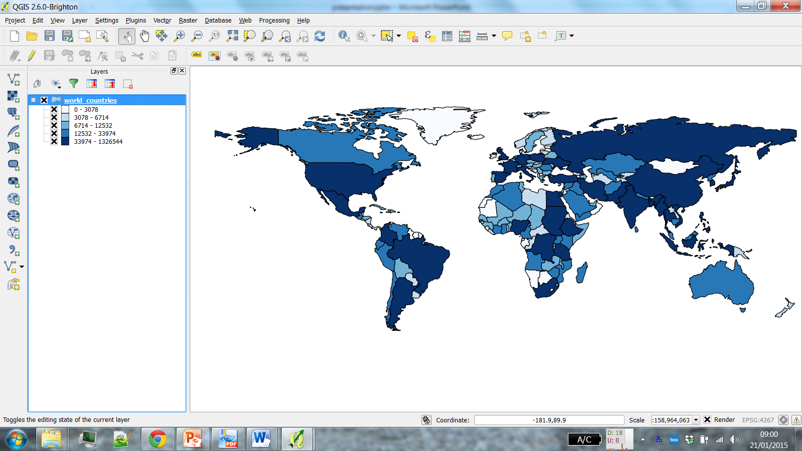
Why is it important?
POP2004
Natural Breaks
(Jenks)
Quantile
(Equal Count)

Slide 56
Why is it important?
POP2004
Natural Breaks
(Jenks)
Quantile
(Equal Count)

Slide 57
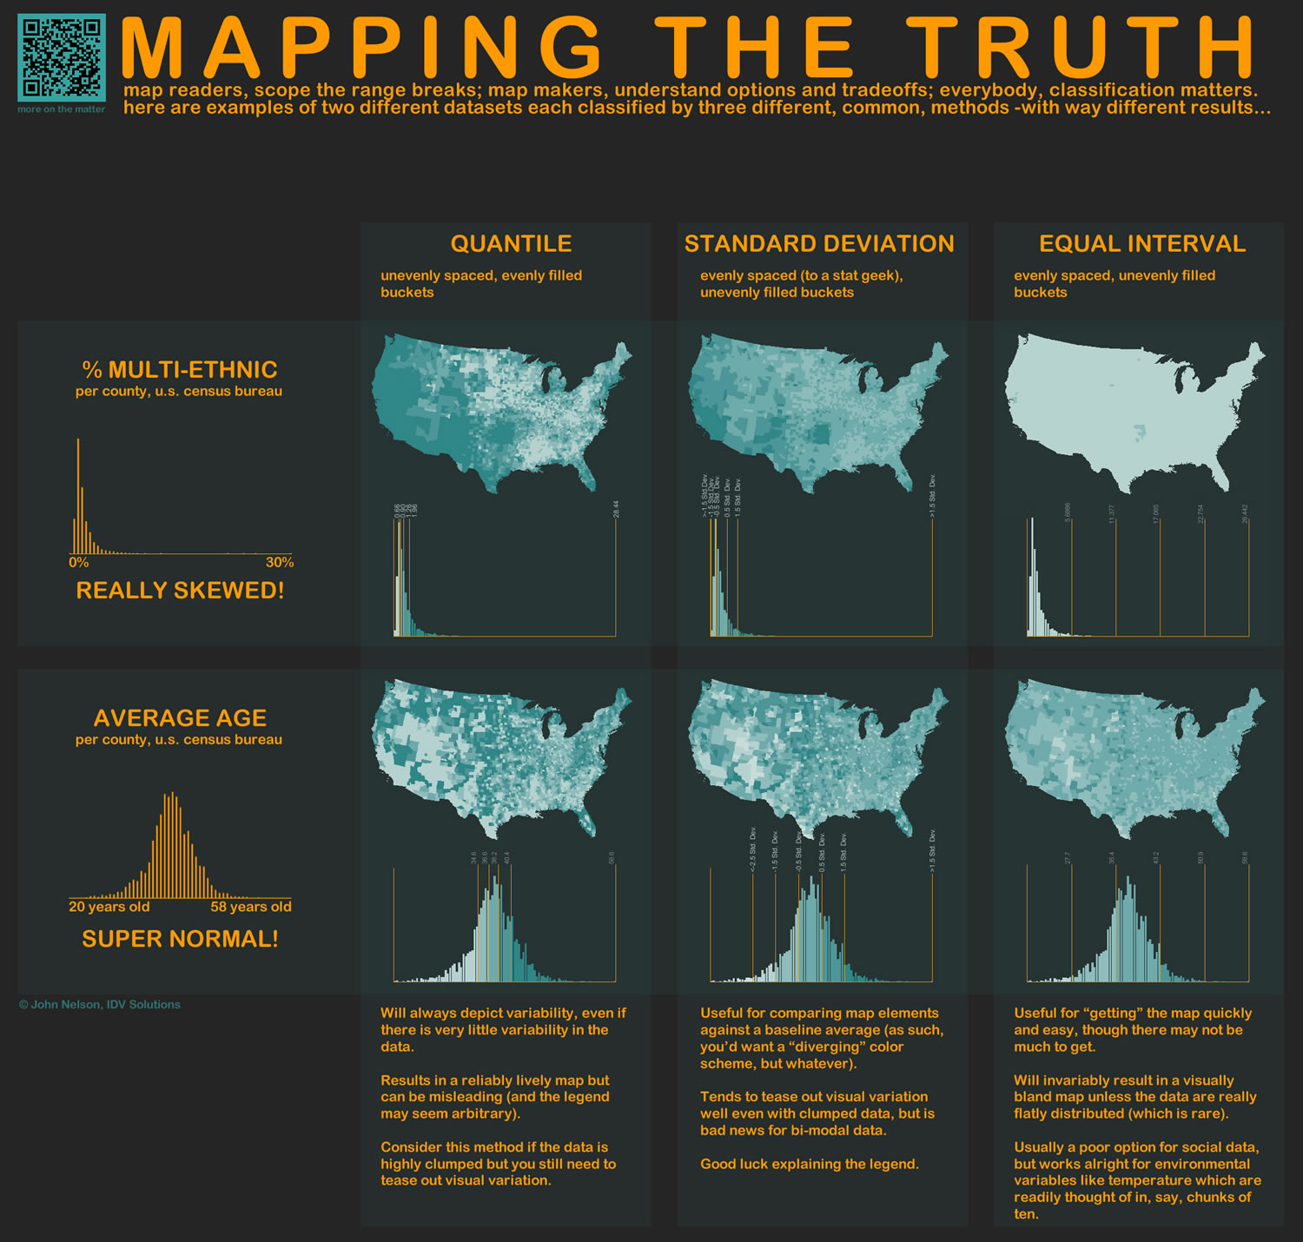
http://www.flickr.com/photos/idvsolutions/6691496421/in/photostream/

Slide 58
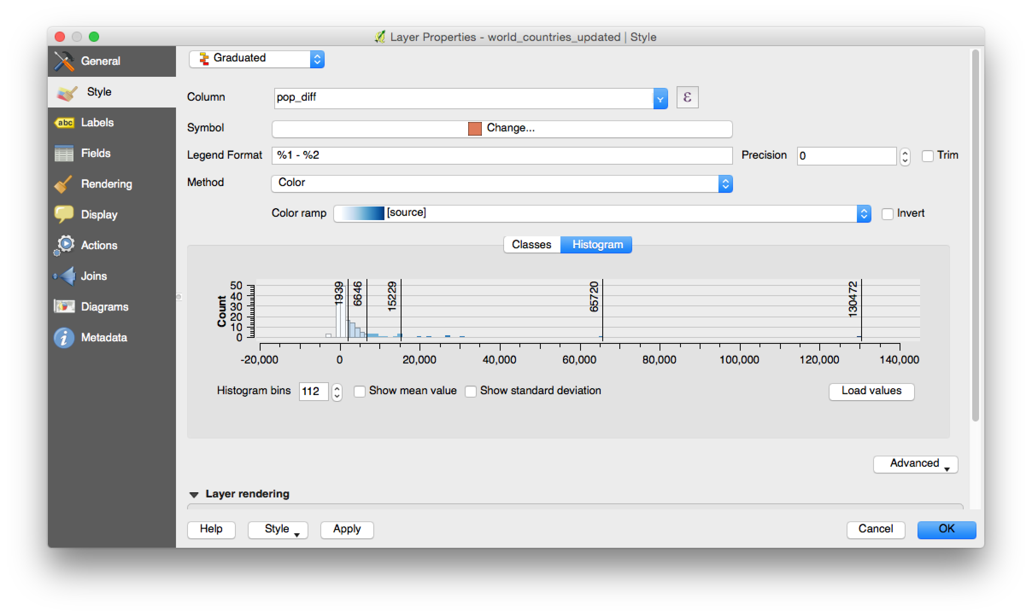
Notes:
Live demo, if possible.

Slide 59

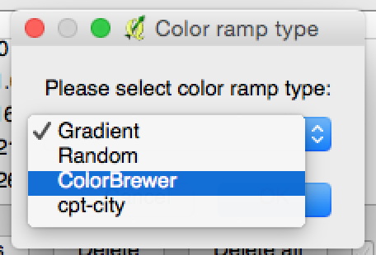
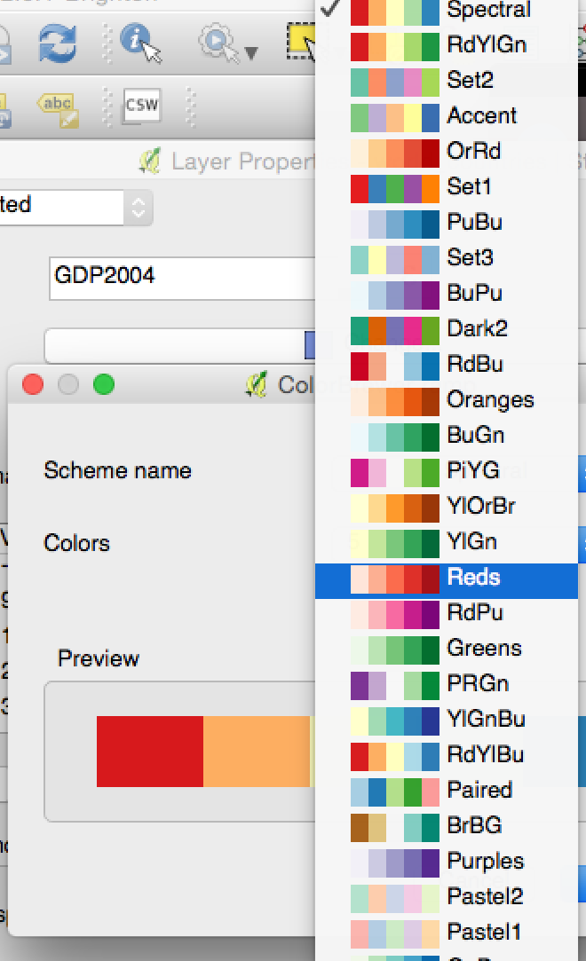
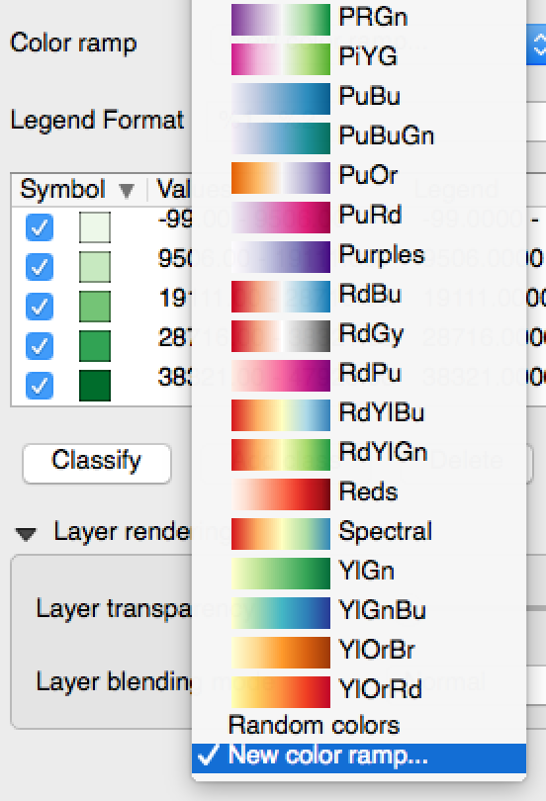
ColorBrewer in QGIS
http://anitagraser.com/2010/08/29/qgis-meets-colorbrewer/

Slide 60
NULL Values
What about missing data?
Null, 0, -9999
Country | Pop 2004 | Pop 2011 | Difference
Luxembourg | 450 | 525 | 75
Switzerland | 7382 | 8014 | 632
France | 59991 | 65653 | 5644
Korea Rep (South) | 48142 | NULL | NULL
Cyprus | 776 | 839 | 63

Slide 61
If NULL is represented using:
Country | Pop 2004 | Pop 2011 | Difference
Luxembourg | 450 | 525 | 75
Switzerland | 7,382 | 8014 | 632
France | 59,991 | 65,653 | 5,644
Korea Rep (South) | 48,142 | 0 | -48,142
Cyprus | 776 | 839 | 63
0
-9999
Country | Pop 2004 | Pop 2011 | Difference
Luxembourg | 450 | 525 | 75
Switzerland | 7,382 | 8,014 | 632
France | 59,991 | 65,653 | 5644
Korea Rep (South) | 48,142 | -9,999 | 58,141
Cyprus | 776 | 839 | 63

Slide 62
Outline of the day
9:40am - 10:00am – What is GIS?
10:00am - 10:20am – Google Earth
10:20am - 11:00am – Prac.1 Intro to QGIS
11:00am - 11:30am – Coffee (room 116)
11:30am - 12:00pm – Classification
12:00pm - 1:00pm – Practical 1 Intro to QGIS 1:00pm - 2:00pm – Lunch (room 116)
2:00pm - 2:15pm – Recap and Map Design
2:15pm - 4:30pm – Practical 2 Tiger Map
Notes:
Practical 2 – Bring Your Own Data

Slide 63
Continue Practical

Slide 64
Classifications

Slide 65
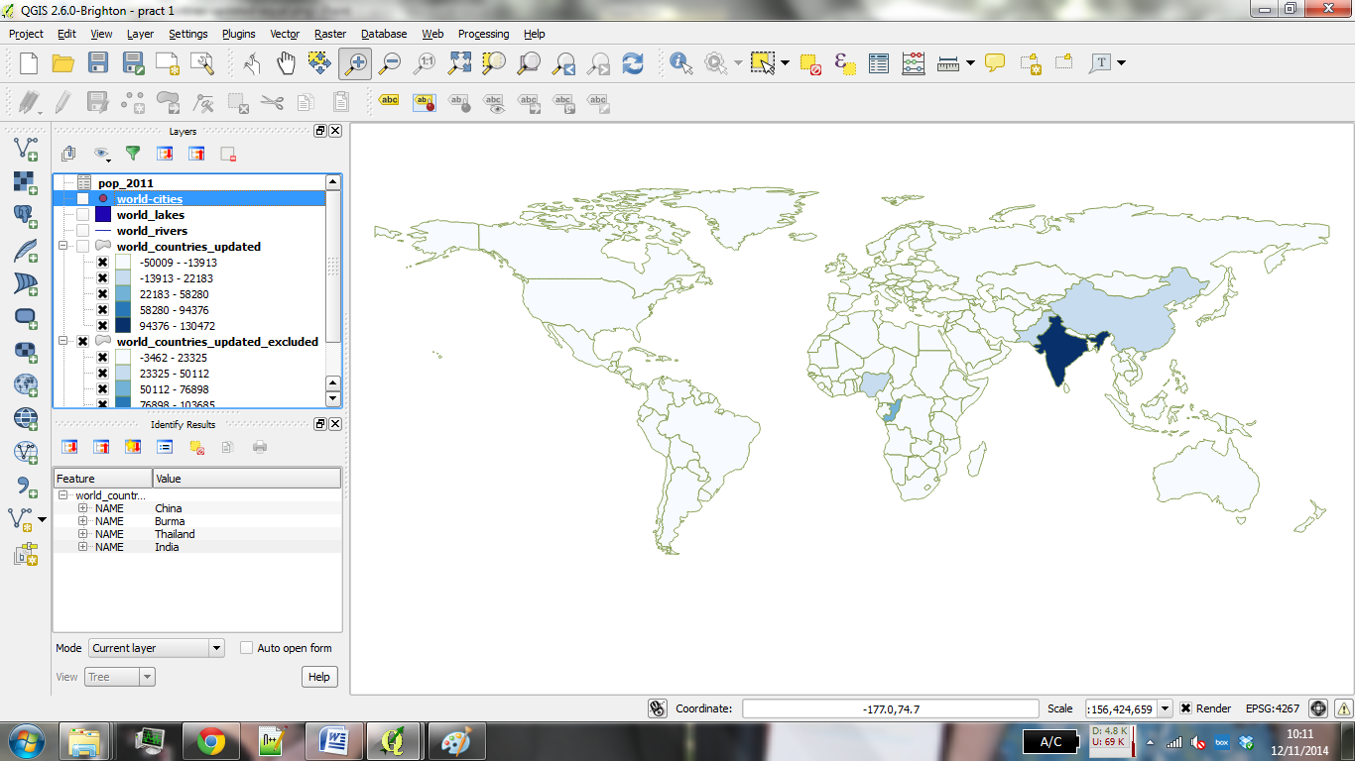
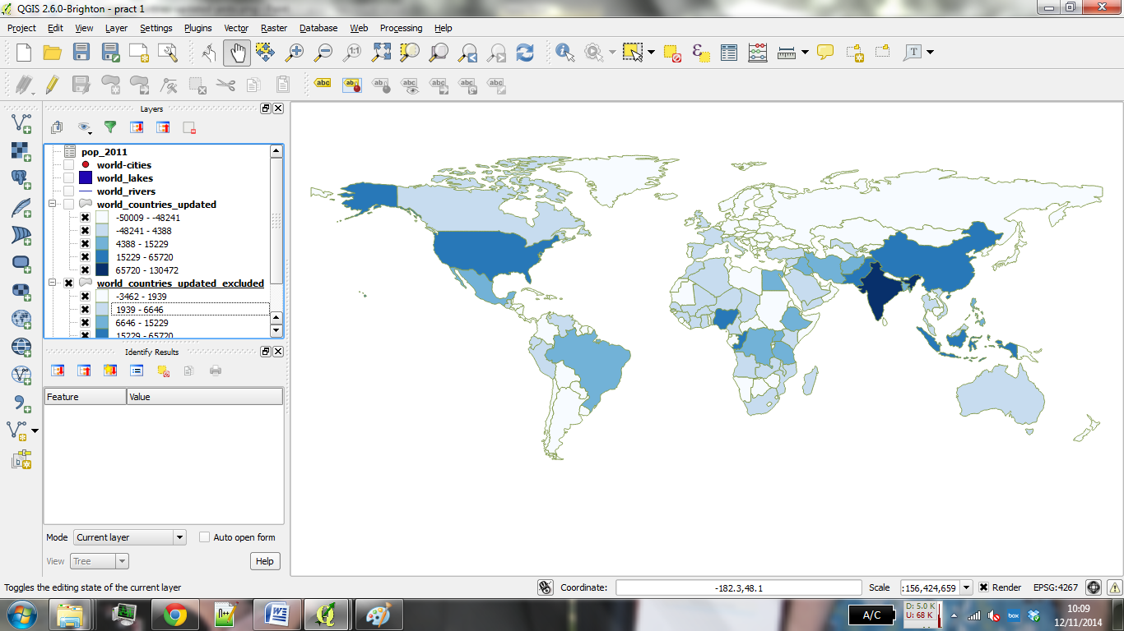
Equal Interval
Jenks

Slide 66
Lunch

Slide 67
Outline of the day
11:30am - 12:00pm – Classification
12:00pm - 1:00pm – Practical 1 Intro to QGIS
1:00pm - 2:00pm – Lunch (room 116)
2:00pm - 2:15pm – Recap & Map Design
2:15pm - 3:15pm – P2 Tiger Map
3:15pm - 3:30pm – Break
3:30pm - 4:30pm – P2 Bring your own data
Notes:
Practical 2 – Bring Your Own Data

Slide 68
Spatial Data
Country boundaries / sub-national boundaries
www.gadm.org
EuroStat
Country spatial data service
GB – Ordnance Survey
Google Search – shapefile / GIS

Slide 69
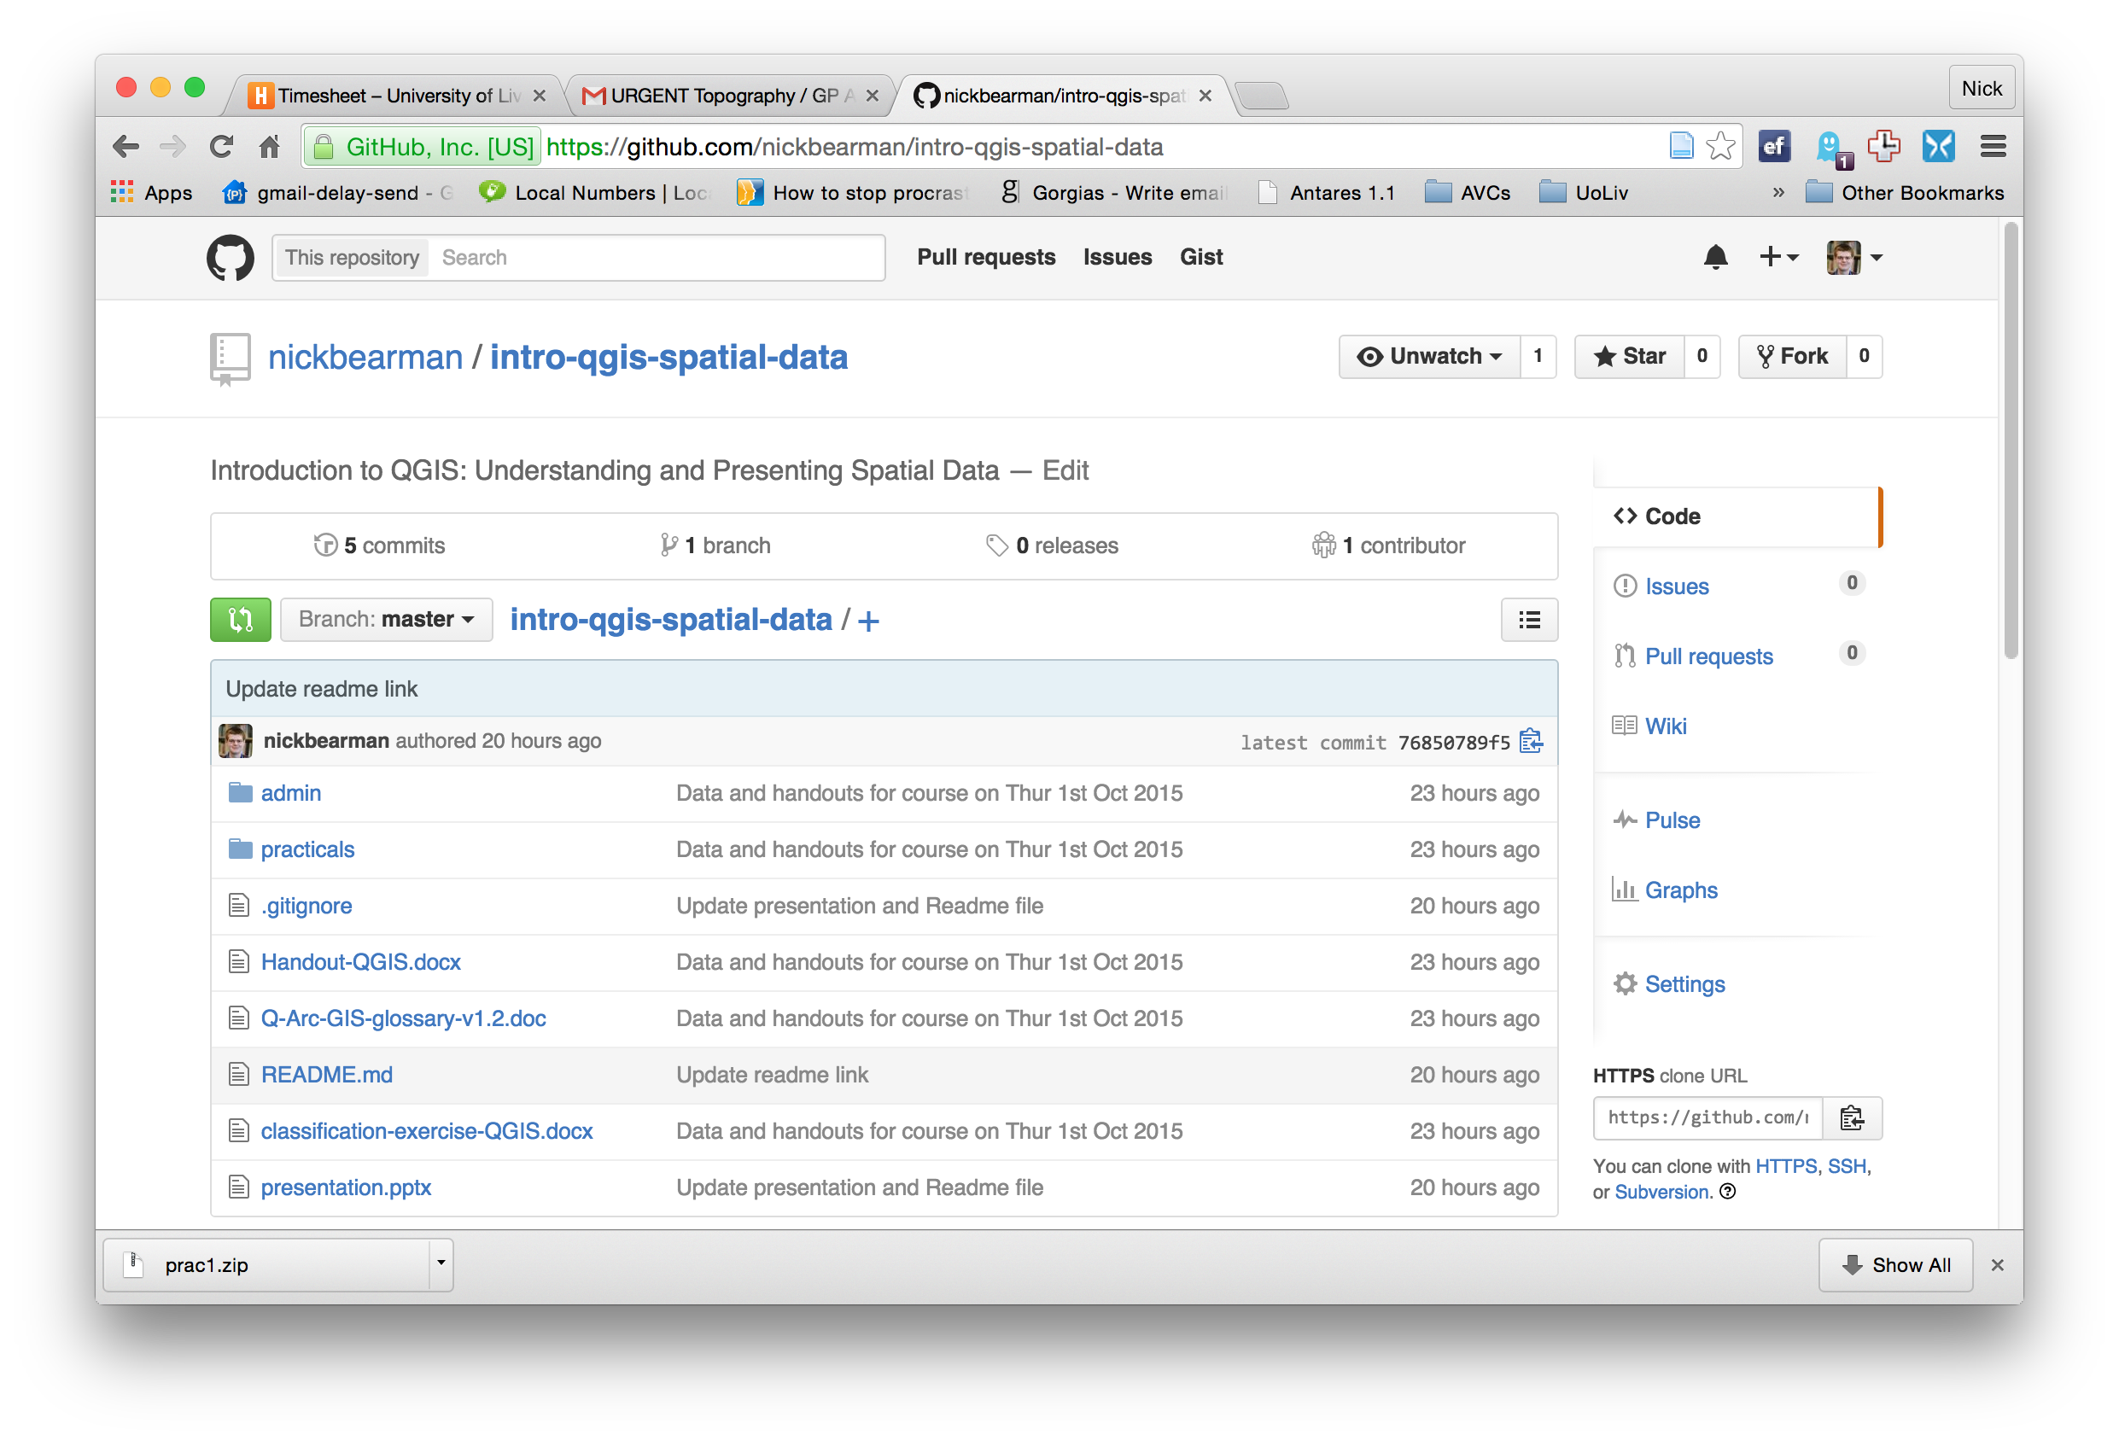

Slide 70
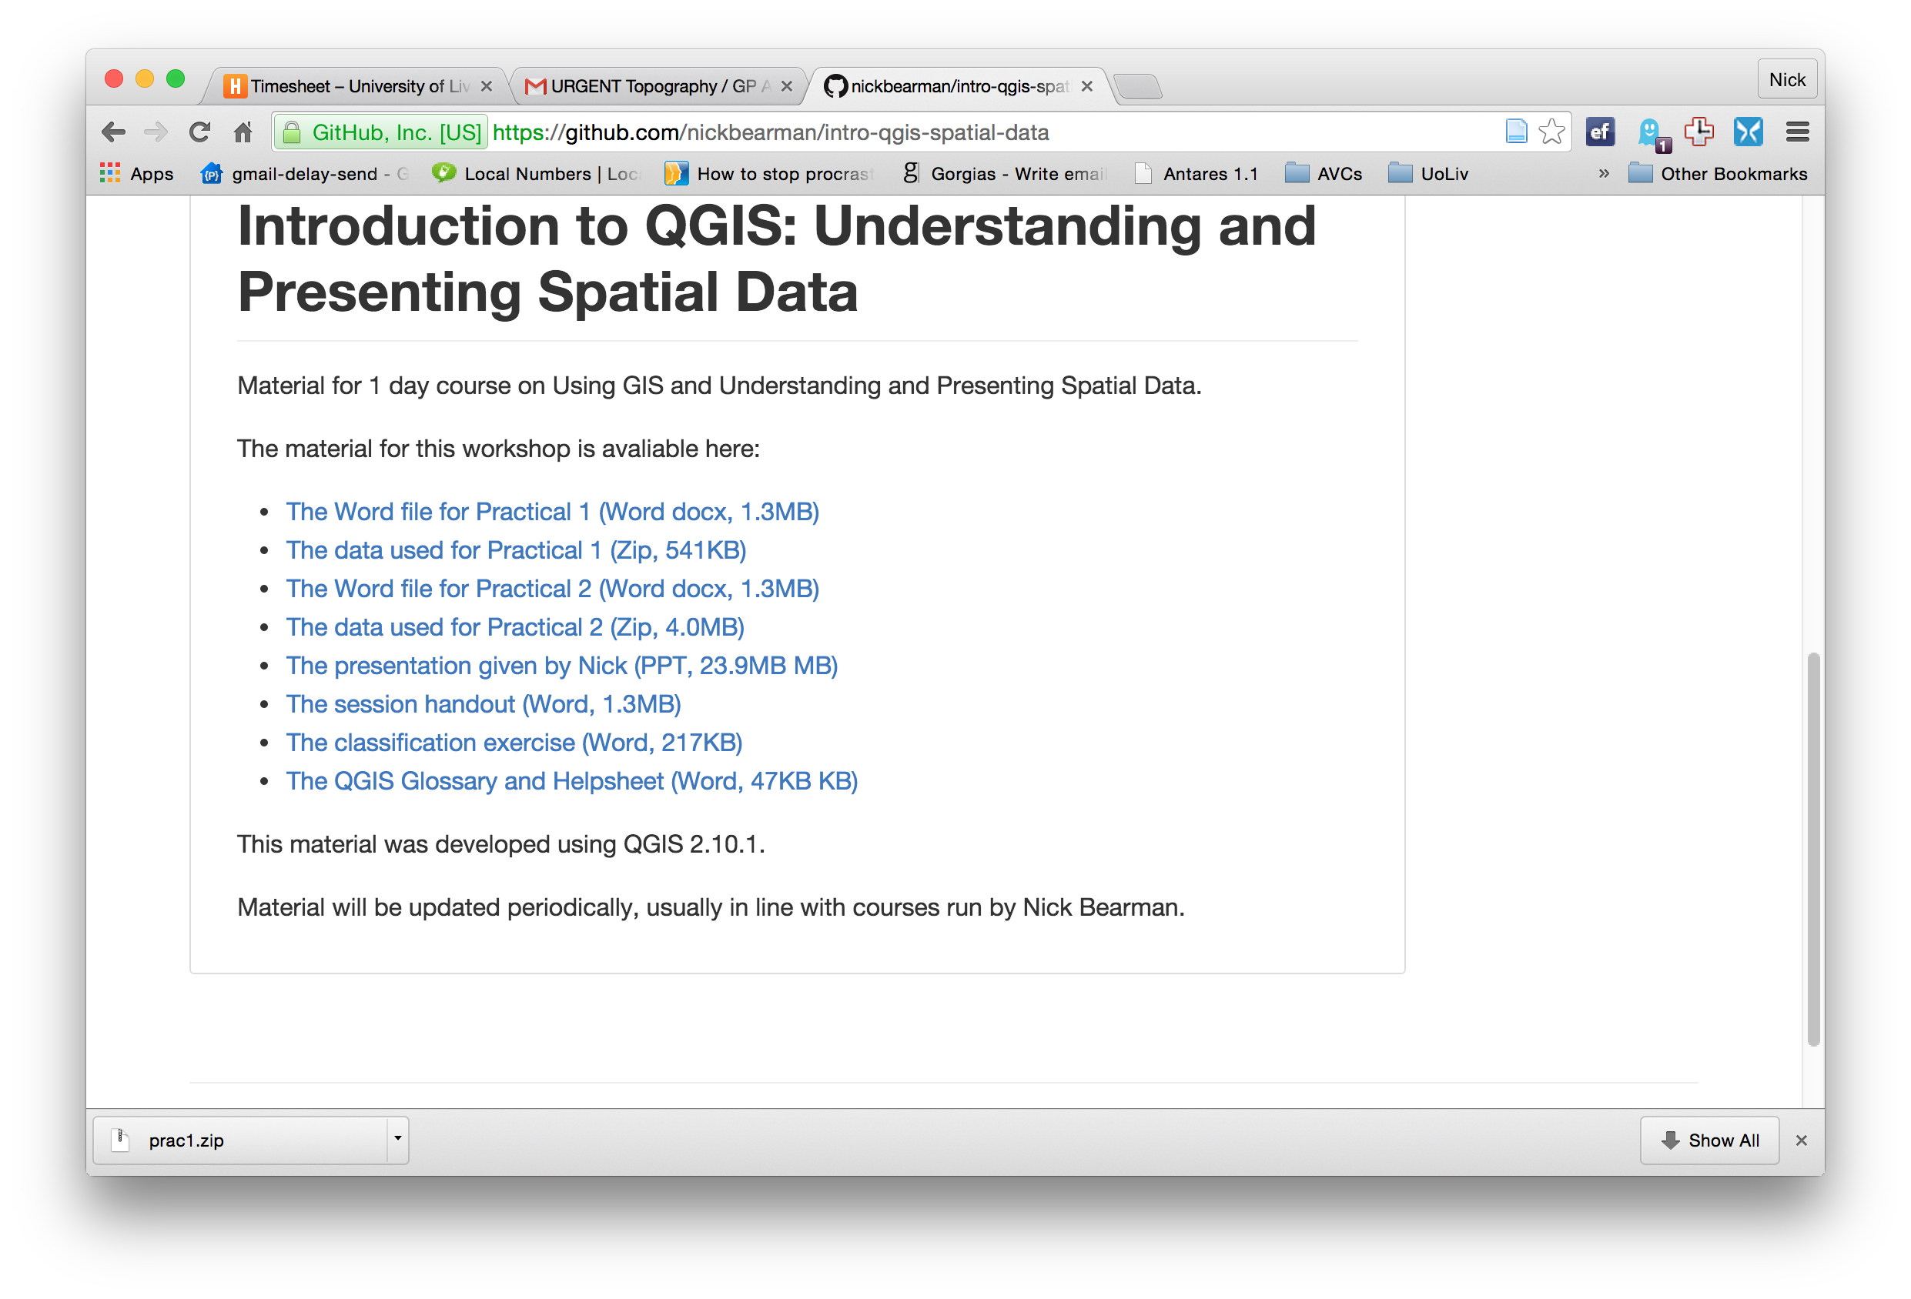

Slide 71



Vector and Raster data
Points, Lines & Polygons
Grid Based
Road networks
Rivers and lakes
Street addresses or postcodes
Administrative areas/boundaries
Elevation
Temperature
Land cover
Population density
Light reflectance (in the form of satellite or aerial imagery)
Notes:
-Raster data is constructed by surveying or sampling at regular intervals on a grid layout.
e.g. soil sample every 500m, or interpolated (estimated) from contours.
-Usually assigned a colour in GIS. Includes images, aerial photos.
-You can convert data between the different formats quite easily in the software for different applications

Slide 72

Shapefile Structure
Notes:
.shp, .dbf, .prj
.qpj, .shx

Slide 73
Tiger Conservation Map
By the end of this practical you will be able to:
Design and produce a publication quality map
Export the map as an image file
Understand how to include legends and scale bars.

Slide 75
Map Design
What makes a good map?

Slide 76
Map Design
Clear
Title (caption), legend, scale bar, N arrow
Data source
Copyright / acknowledgements

Slide 78


Slide 79
Break

Slide 80
Outline of the day
11:30am - 12:00pm – Classification
12:00pm - 1:00pm – Practical 1 Intro to QGIS
1:00pm - 2:00pm – Lunch (room 116)
2:00pm - 2:15pm – Recap & Map Design
2:15pm - 3:15pm – P2 Tiger Map
3:15pm - 3:30pm – Break
3:30pm - 4:30pm – P2 Bring your own data
Notes:
Practical 2 – Bring Your Own Data

Slide 81
Using your own data
Get it in to QGIS
Join it
Look at the attribute data and create new variables
Map it
Or use the Age Structure North West Data mentioned in Practical 2
I will come around on a 1-to-1 basis

Slide 83


Common Problems in Mapping
Data availability
Google, other work
Losing work
Saving, backups, testing backups
Specific feature not working
Restart and try again
Google, Stack Exchange (http://gis.stackexchange.com/)
How do I do x in y?
Google, colleagues

Slide 84
Next Steps
QGIS Plugins
http://docs.qgis.org/2.2/en/docs/training_manual/
Courses:
Intro to R as a GIS (1 day, Liverpool)
R & Spatial Analysis (1 day, Liverpool)
An Introduction to Spatial Microsimulation Using R (2 day, Leeds)
Spatial Data Analysis for Decision Making (35 hours 2 weeks, Essex)

Slide 85
Feedback
Feedback is really important for me
Online survey will be emailed
(paper copies available)
Or email / phone / in person

